Slide 1
DRUG TRAFFICKING
COLOMBIA

Slide 2
DRUG TRAFFICKING
COLOMBIA

Slide 3
This timeline explores the rise and evolution of drug trafficking in Colombia, tracing its beginnings, geographical shifts, and current state.

Slide 4
1974
1979
DEA EFFORTS
RECORDS
The DEA began to link seemingly isolated cocaine seizures, uncovering a well-organized smuggling effort orchestrated from Colombia.
Drug use in the U.S. reached an all-time high, with two-thirds of young adults and one in five adults reporting having used an illicit drug
Early 1970s
Mid 1970s
INTERNATIONAL EXPANSION
PABLO ESCOBAR
Colombia emerged as a major supplier of cocaine to the U.S., following the crackdown on Mexican traffickers. Colombian marijuana traffickers began to export small quantities of cocaine. Increased cocaine production and trafficking led to significant price drops, making the drug more accessible to a wider population
The Medellin Cartel, led by Pablo Escobar, became the dominant organization in the cocaine trade. Drug trafficking fueled violence, corruption, and political instability in Colombia.

Slide 5
Colombia emerged as a major supplier of cocaine to the U.S., following the crackdown on Mexican traffickers. Colombian marijuana traffickers began to export small quantities of cocaine. Increased cocaine production and trafficking led to significant price drops, making the drug more accessible to a wider population.

Slide 6
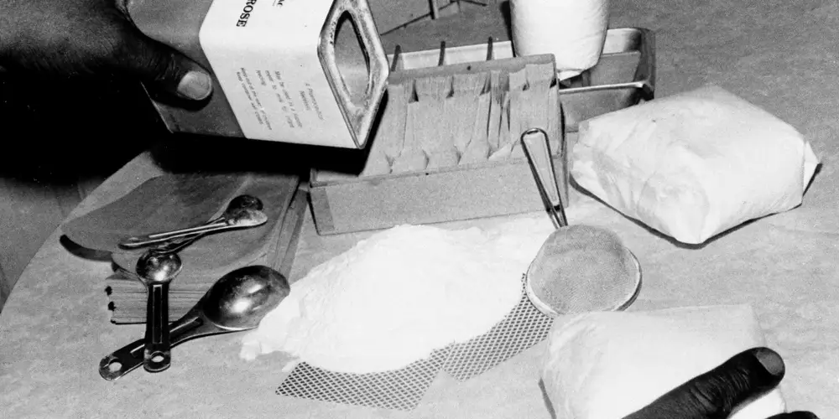
Inside a New York City heroin factory, pure heroin, taken from bags such as the three kilo bags shown here in April 1974, is being mixed, or cut, with dextrose.

Slide 7
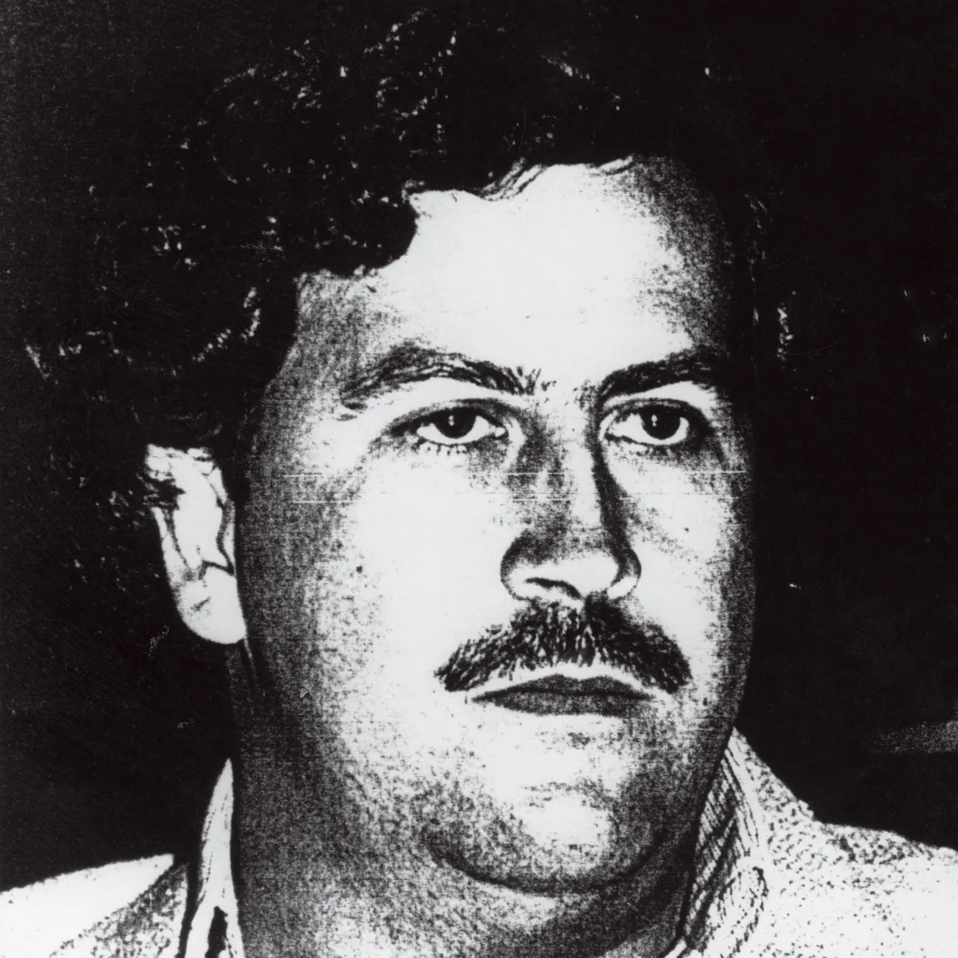

Slide 8
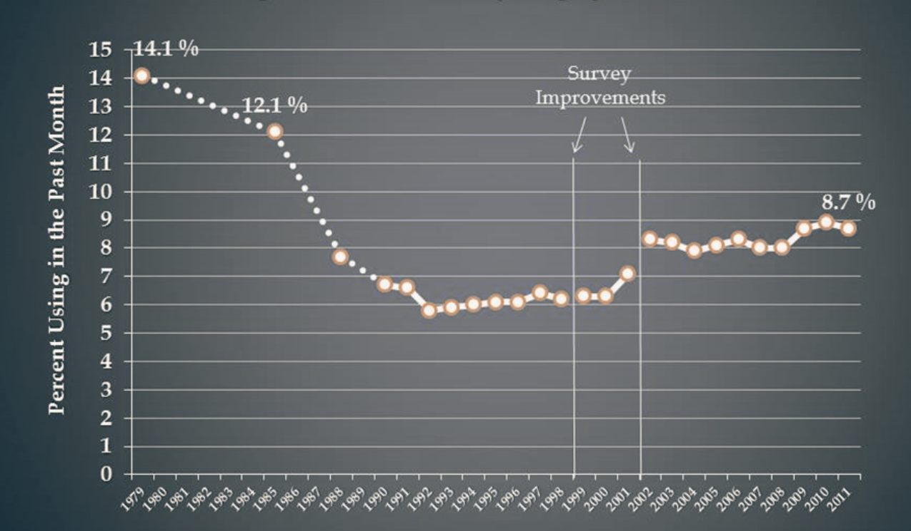
.

Slide 9
1974
1979
DEA EFFORTS
RECORDS
The DEA began to link seemingly isolated cocaine seizures, uncovering a well-organized smuggling effort orchestrated from Colombia.
Drug use in the U.S. reached an all-time high, with two-thirds of young adults and one in five adults reporting having used an illicit drug.
Early 1970s
Mid 1970s
INTERNATIONAL EXPANSION
PABLO ESCOBAR
Colombia emerged as a major supplier of cocaine to the U.S., following the crackdown on Mexican traffickers. Colombian marijuana traffickers began to export small quantities of cocaine. Increased cocaine production and trafficking led to significant price drops, making the drug more accessible to a wider population.
The Medellin Cartel, led by Pablo Escobar, became the dominant organization in the cocaine trade. Drug trafficking fueled violence, corruption, and political instability in Colombia.

Slide 10
1990s
1999
PEAK AND PRESSUE
COCA PRODUCTION SOARS
The Medellín Cartel reaches its peak under Escobar but faced intense pressure from the Colombian government and rival cartels.
Colombia becomes the world’s largest producer of coca, the raw material for cocaine. Drug trafficking affects the environment, the economy, and the society of Colombia.
1980s
1993
INTERNATIONAL EXPANSION
DEATH AND DECLINE
Cocaine trafficking expanded to Europe and other parts of the world, making Colombia a global hub for the drug trade. The Medellin Cartel waged a war against the Colombian government and its rivals, the Cali Cartel.
Escobar is killed. His death marked the decline of the Medellin cartel. The Cali Cartel took over the cocaine market after its fall. By the end of the decade, both the Medellin and Cali Cartels are dismantled, leading to fragmentation of the drug trade into smaller groups.

Slide 11
INTERNATIONAL EXPANSION
Cocaine trafficking expanded to Europe and other parts of the world, making Colombia a global hub for the drug trade. The Medellin Cartel waged a war against the Colombian government and its rivals, the Cali Cartel.

Slide 12
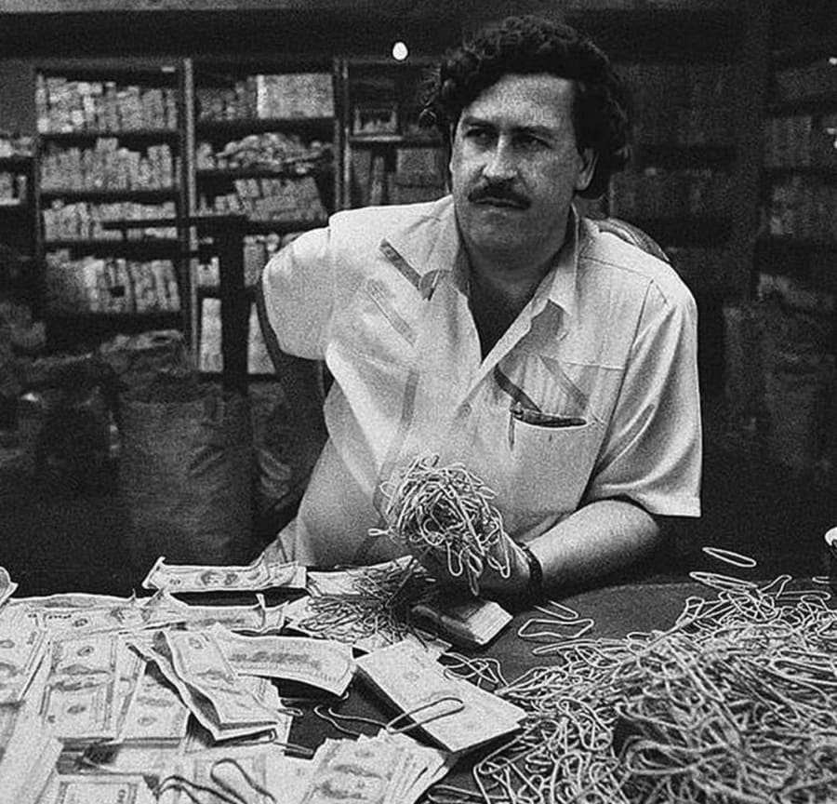
At its height, the Medellín Cartel earned as much as $4 billion a year—most of it cash—for its members and controlled 80 percent of the cocaine supply in the U.S.

Slide 13
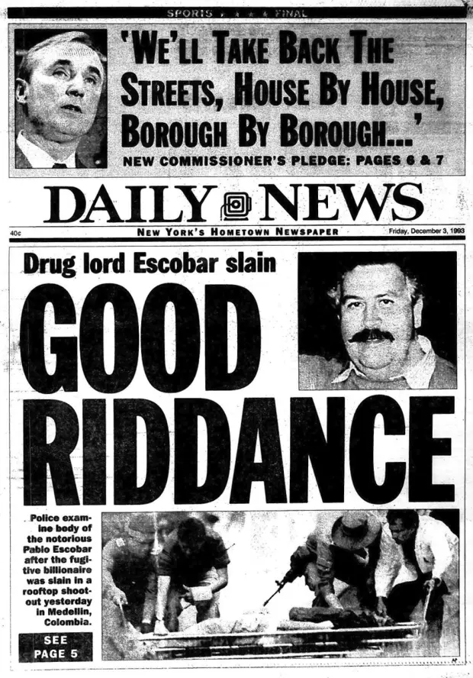
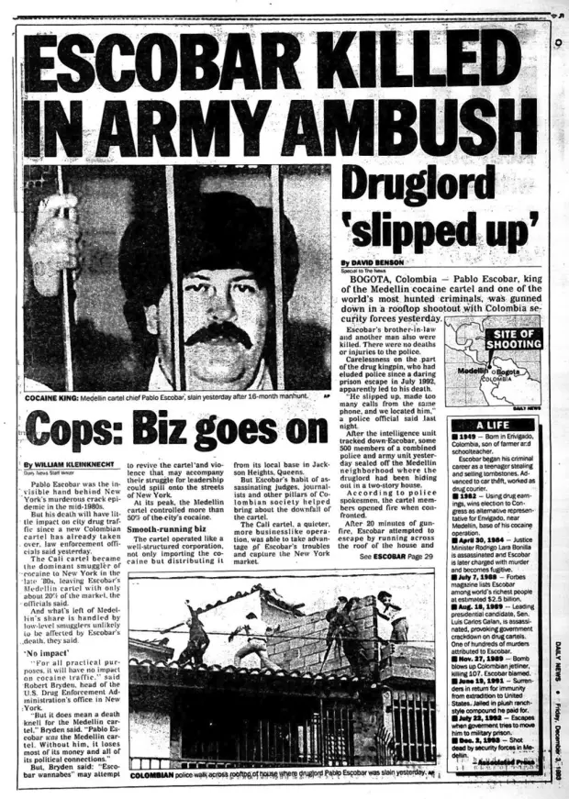
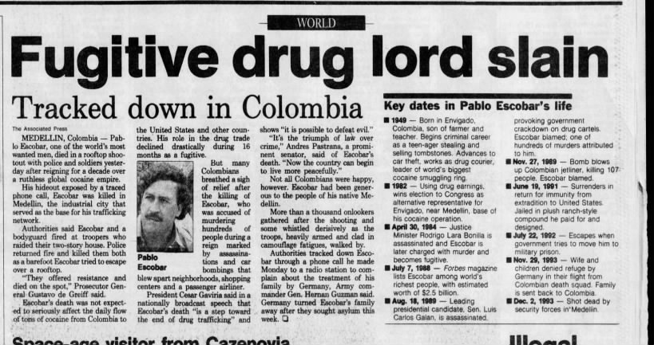

Slide 14
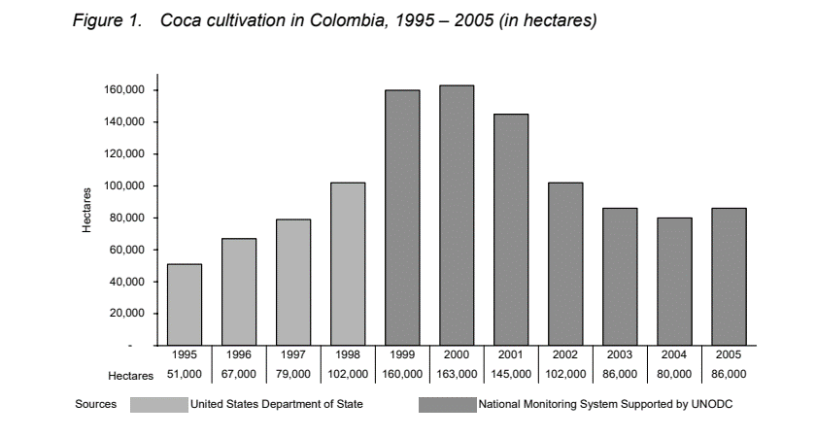
In 2000, the coco cultivation surpassed the 1999 record.

Slide 15
1990s
1999
PEAK AND PRESSUE
COCA PRODUCTION SOARS
The Medellín Cartel reaches its peak under Escobar but faced intense pressure from the Colombian government and rival cartels.
Colombia becomes the world’s largest producer of coca, the raw material for cocaine. Drug trafficking affects the environment, the economy, and the society of Colombia.
1980s
1993
INTERNATIONAL EXPANSION
DEATH AND DECLINE
Cocaine trafficking expanded to Europe and other parts of the world, making Colombia a global hub for the drug trade. The Medellin Cartel waged a war against the Colombian government and its rivals, the Cali Cartel.
Escobar is killed. His death marked the decline of the Medellin cartel. The Cali Cartel took over the cocaine market after its fall. By the end of the decade, both the Medellin and Cali Cartels are dismantled, leading to fragmentation of the drug trade into smaller groups.

Slide 16
2000s
2020s
INTERNATIONAL COOPERATION
DIVERSIFICATION
The U.S. and Colombia implement Plan Colombia, a multibillion-dollar initiative to eradicate coca crops, combat the drug traffickers and the guerrillas, and strengthen the democratic institutions and the rule of law in Colombia.
Colombia becomes increasingly involved in the production and trafficking of synthetic drugs .
Early 2000s
2010s
NEW FACTIONS EMERGE
ADAPTATION
Paramilitary groups emerge, financed by the drug trade and engaging in violence against leftist groups and civilians. Millions of Colombians are internally displaced due to violence associated with the drug trade.
Colombia and the U.S. shift their strategy from a militarized approach to a more comprehensive and balanced one, focusing on alternative development, prevention, and treatment.

Slide 17
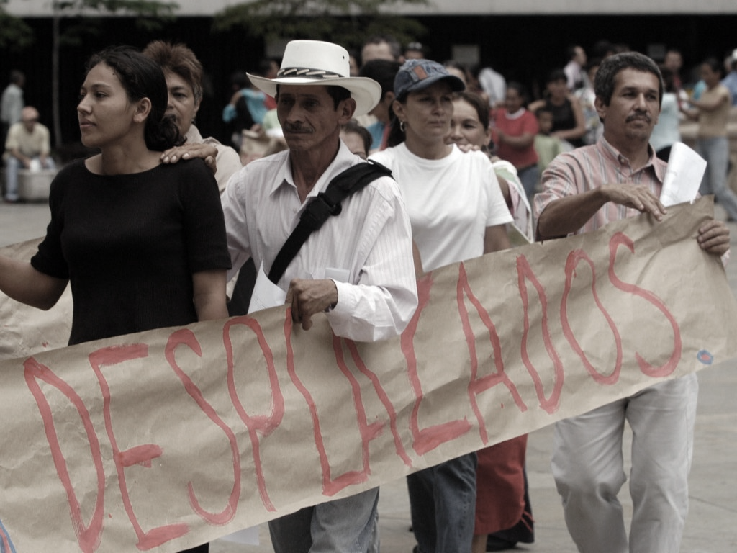

Slide 18
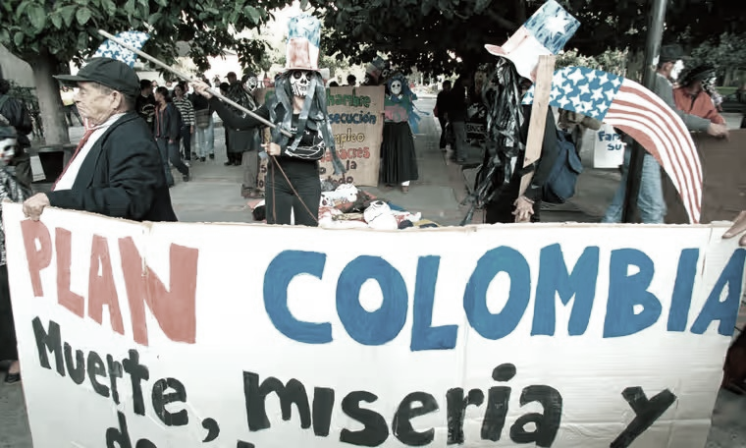
Plan Colombia is met with mixed reviews within Colombia.
Photo: Colombian university students stage a protest against the Plan in 2001

Slide 19
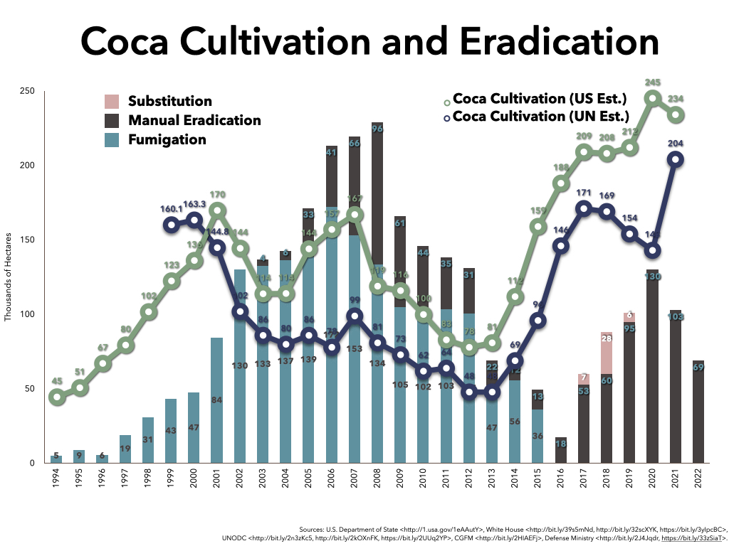

Slide 21
2000s
2020s
INTERNATIONAL COOPERATION
DIVERSIFICATION
The U.S. and Colombia implement Plan Colombia, a multibillion-dollar initiative to eradicate coca crops, combat the drug traffickers and the guerrillas, and strengthen the democratic institutions and the rule of law in Colombia.
Colombia becomes increasingly involved in the production and trafficking of synthetic drugs .
Early 2000s
2010s
NEW FACTIONS EMERGE
ADAPTATION
Paramilitary groups emerge, financed by the drug trade and engaging in violence against leftist groups and civilians. Millions of Colombians are internally displaced due to violence associated with the drug trade.
Colombia and the U.S. shift their strategy from a militarized approach to a more comprehensive and balanced one, focusing on alternative development, prevention, and treatment.

Slide 22
TODAY
TRAFFICKING, CORRUPTION, AND ADDICTION
The Colombian government has taken measures to stifle the cultivation and trafficking of illicit drugs; however, the effects continue to be felt on both a local and global level. It remains the world's biggest cocaine producer despite the government’s attempted crackdown. As a transnational crime, drug trafficking does not stand alone. It remains an incredibly prosperous industry that continues to weaken Colombia with corruption, incites violence through criminal organizations, and ultimately contributes to the proliferation of addiction globally.
THE OPIOD CRISIS
Addiction feeds demand. Demand reinforces the need for supply. Illicit drugs, as well as the transnational and domestic criminal organizations that traffic them, continue to represent significant threats to public health, law enforcement, and national security in the U.S

Slide 25
TODAY
TRAFFICKING, CORRUPTION, AND ADDICTION
The Colombian government has taken measures to stifle the cultivation and trafficking of illicit drugs; however, the effects continue to be felt on both a local and global level. It remains the world's biggest cocaine producer despite the government’s attempted crackdown. As a transnational crime, drug trafficking does not stand alone. It remains an incredibly prosperous industry that continues to weaken Colombia with corruption, incites violence through criminal organizations, and ultimately contributes to the proliferation of addiction globally.
THE OPIOD CRISIS
Addiction feeds demand. Demand reinforces the need for supply. Illicit drugs, as well as the transnational and domestic criminal organizations that traffic them, continue to represent significant threats to public health, law enforcement, and national security in the U.S

Slide 26
REFERENCES
Buchholz, Katharina. “Cocaine Cultivation Reaches New High in 2021.” Statista, April 18, 2023. https://www.statista.com/chart/5749/the-globes-top-cocaine-producers/.
Drug Enforcement Administration. “The Drug Enforcement Administration (DEA) 1975-1980.” DEA History, Accessed December 5, 2023. https://www.dea.gov/sites/default/files/2021-04/1975-1980_p_39-49.pdf.
Benson, David. “Drug kingpin Pablo Escobar killed in an army ambush in 1993” New York Daily News, Image, December 1, 2016. https://www.nydailynews.com/2016/12/01/drug-kingpin-pablo-escobar-killed-in-an-army-ambush-in-1993/.
Brodzinsky, Sibylla. “Plan Colombia's mixed legacy: coca thrives but peace deal may be on horizon.” The Guardian, Image, February 3, 2016. https://www.theguardian.com/world/2016/feb/03/plan-colombia-cocaine-narcotics-farc-peace-deal
Buchholz, Katharina. “Cocaine Cultivation Reaches New High in 2021.” Statista, April 18, 2023. https://www.statista.com/chart/5749/the-globes-top-cocaine-producers/.
“December 3, 1993 Fugitive drug lord slain.” Newspapers.com. https://www.newspapers.com/article/democrat-and-chronicle-december-3-1993/10993698/.
Drug Enforcement Administration. “The Drug Enforcement Administration (DEA) 1975-1980.” DEA History, Accessed December 5, 2023. https://www.dea.gov/sites/default/files/2021-04/1975-1980_p_39-49.pdf.
Drug Enforcement Administration. “The Drug Enforcement Administration (DEA) 1990-1994.” DEA History, Accessed December 5, 2023. https://www.dea.gov/sites/default/files/2021-04/1990-1994_p_67-76.pdf.
European monitoring Centre for Drugs and Drug Addiction. “Coca and cocaine production.” EMCDDA and Europol, May 6, 2022. https://www.emcdda.europa.eu/sites/default/files/pdf/14571_en.pdf?581642.
Green, Peter S. “The Ever-Changing Logistics of Drug Smuggling.” The Wall Street Journal, Accessed December 8, 2023. https://www.wsj.com/ad/cocainenomics.
Katz, Jesse. “Pablo Escobar Will Never Die.” Pablo-Escobar GQ 2015, GQ Magazine Image, August 25, 2015. https://www.gq.com/story/pablo-escobar-legacy.

Slide 27
REFERENCES
LeGrand, Catherine C. 2003. "The Colombian Crisis in Historical Perspective." Canadian Journal of Latin American & Caribbean Studies 28 (55): 165-209. http://ezproxy.bellevue.edu/login?url=https://www.proquest.com/scholarly-journals/colombian-crisis-historical-perspective/docview/220252348/se-2.
Lemaitre, Rafael. “Are Drugs Today Really Cheaper, Purer, and More Available Than Ever?” The White House, President Barack Obama, Blog, February 12, 2013. https://obamawhitehouse.archives.gov/blog/2013/02/12/are-drugs-today-really-cheaper-purer-and-more-available-ever.
Shifter, Michael. “Plan Colombia: A Retrospective.” America’s Quarterly, Image July 18, 2012. https://www.americasquarterly.org/fulltextarticle/plan-colombia-a-retrospective/.
Thompson, D. P. 1996. “Pablo Escobar, Drug Baron: His Surrender, Imprisonment, and Escape.” Studies in Conflict and Terrorism 19 (1): 55-91.
United Nations Office on Drugs and Crime (UNODC). 2005. “Part 4. Colombia Coca Cultivation Survey.” Colombia Coca Survey for 2005. https://www.unodc.org/pdf/andean/Andean_report_Part4.pdf.
United Nations Office on Drugs and Crime (UNODC). 2021. Synthetic Drugs and New Psychoactive Substances in Latin America and the Caribbean 2021 (September 2021).
United Nations Office on Drugs and Crime (UNODC). 2023. “Global report on Cocaine 2023: Local dynamics, global challenges.” United Nations publication. https://www.unodc.org/documents/data-and-analysis/cocaine/Global_cocaine_report_2023.pdf.
WOLA. “Coca Cultivation and Eradication.” Image, July 11, 2023. https://colombiapeace.org/tag/illicit-crop-eradication/.
Woody, Christopher. “Pablo Escobar was gunned down 29 years ago — here are 3 theories about who took the Medellin kingpin's life.” Business Insider, Image, December 2, 2022. https://www.businessinsider.com/who-killed-notorious-colombian-drug-kingpin-pablo-escobar-2016-12.
Woody, Christopher. “How the US got its first big break against Colombia's Cali cartel in a Queens, New York, bathtub.” Business Insider, June 17, 2018. https://www.businessinsider.com/us-cocaine-bust-against-cali-cartel-in-a-queens-new-york-city-bathtub-2017-10.
Yagoub, Mimi. “Displacement Rising as Colombia’s Conflict Moves into New Phase.” InSight Crime, Image, June 16, 2016.

Slide 28
PRESENTATION BY
Kjersti Søberg
Bellevue University
Masters in Intelligence and Security Studies
PS620-T301 Transnational Crime & Corruption

